Slide 1
Big Data Architecture and Governance
Group Project | Team 8
Prathamesh Verlekar
Saurabh Satra
Yash Pandya

Slide 2
Dataset : US Permanent Visa Applications
Kaggle Link: https://www.kaggle.com/jboysen/us-perm-visas
This Dataset gives detailed information of around 374K visa applications and its decision.
Data covers 2011-2016 and includes information on employer, position, wage offered, job posting history, employee education and past visa history, and final decision.
This data was collected and distributed by the US Department of Labor.

Slide 3
Impact Statement Guide
The purpose of this project is to derive insights using USCIS visa application dataset that would improve the understanding and experience of USCIS, corporates filing visa application of employees and people applying for the visa application.

Slide 4
Project Objectives
To clean and validate the data extracted from USCIS website
Create a data model for the given dataset
Create a database in Neo4j and load the dataset using Cypher queries
Create a data pipeline for connecting Neo4j to Python
Build an interactive dashboard for better insights
Integration and Acceptance testing for data validation

Slide 5
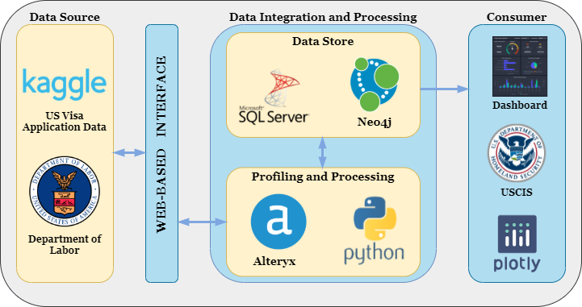
Vision Diagram

Slide 6
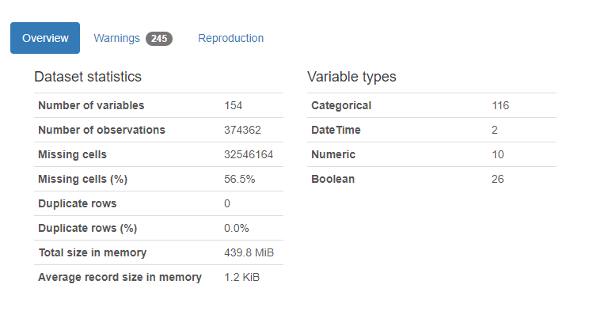
Data Profiling
Pandas Profiling
Pandas profiling is an open-source Python module with which we can quickly do an exploratory data analysis with just a few lines of code.
It also generates interactive reports in web format that can be presented to any person, even if they do not know programming.

Slide 7
Observations
From the pandas profiling overview, we can analyze that the dataset has 374362 observations out of which 373025 are unique observations. The dataset has 154 variables out of which only 21 variables have more than 330000 non-missing observations.
The higher Missing cells % is because of the remaining variables which have more than 50% of missing values.
The Dataset has,
116 Categorical values
2 Date Time values
10 Numerical values
26 Boolean values

Slide 8
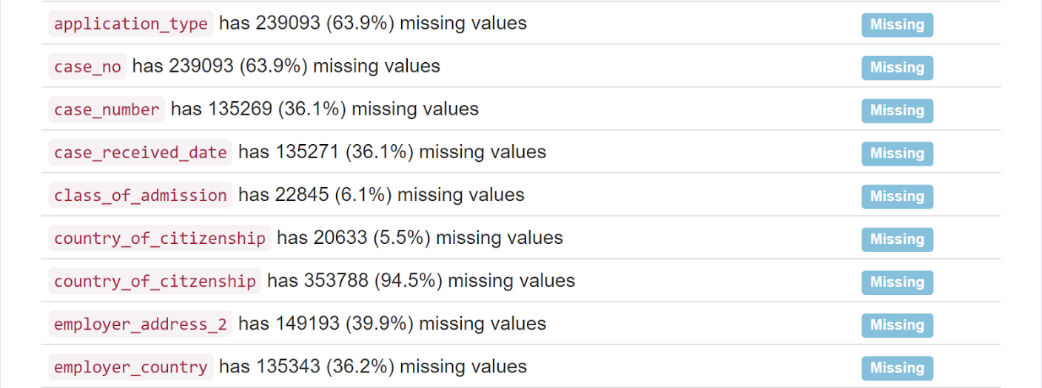
Data Profiling – Missing Values
Percentage of Missing values in the columns selected for analysis
For handling Missing values in the dataset for selected columns, we have replaced them with a value “Not Provided”.

Slide 9
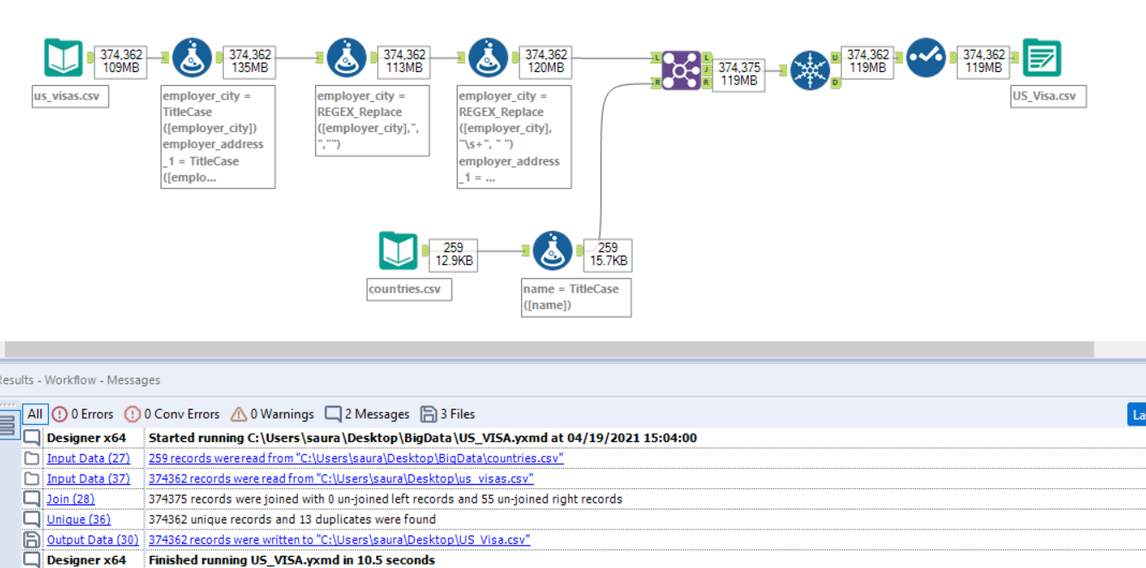
Data Preprocessing - Alteryx
Alteryx Workflow for Cleaning the dataset which includes removing blank spaces, extra commas, and Capitalization.

Slide 10
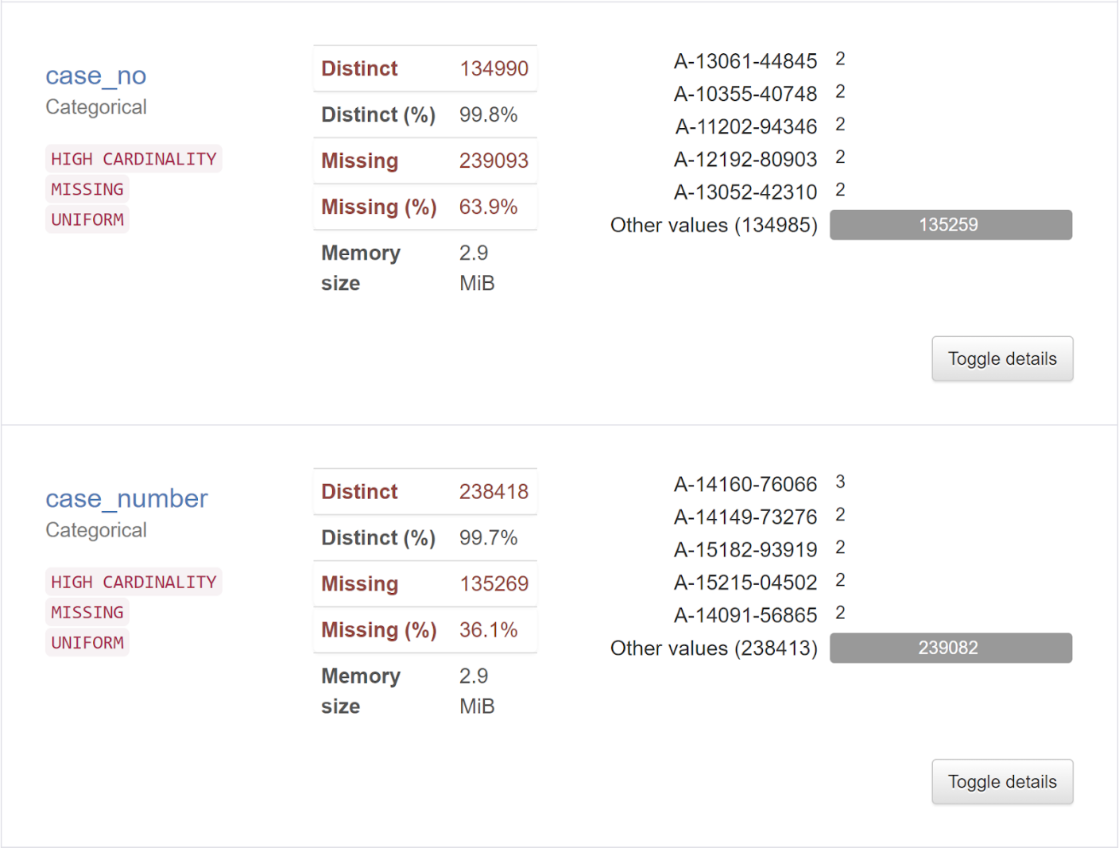
Data Preprocessing - Python
Steps Involved in Data Preprocessing
There are two columns one case_no and other case_number, we have data for either one which means these two columns are the same. We created a new column casenumber by merging these two columns. The new created column case number has 373025 unique observations.

Slide 11
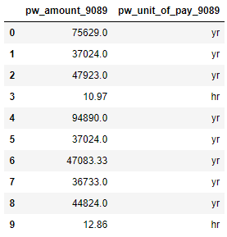
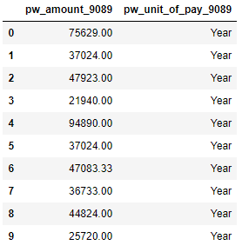
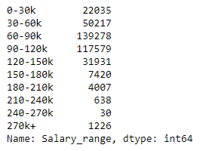
Data Preprocessing - Python
We used permanent wage amount column and permanent wage unit of pay column to derive a new column that has amount per year values.
Then, we created a derived column salary range for analysis purpose.

Slide 12
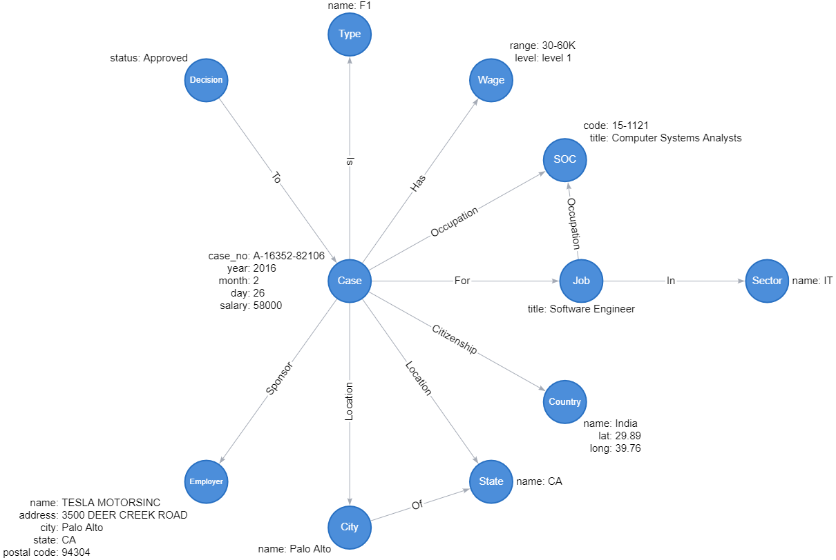
Data Model

Slide 13
Database - Neo4j
Neo4j database is a graph database and is used to represent the data in the form of graphs.
Everything is stored in the form of an edge, node, or attribute. Each node and edge can have any number of attributes
It offers data integrity and is ACID (Atomic, Consistent, Isolated, Durable) compliant.
Just like RDBMS has a language called SQL to access data, the Graph database has a language called Cypher.

Slide 14
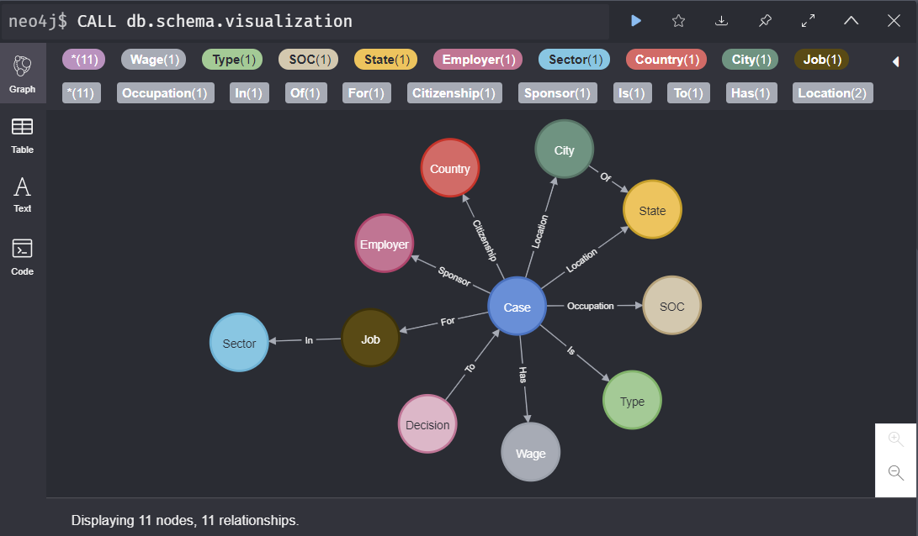
Database Schema in Neo4j

Slide 15
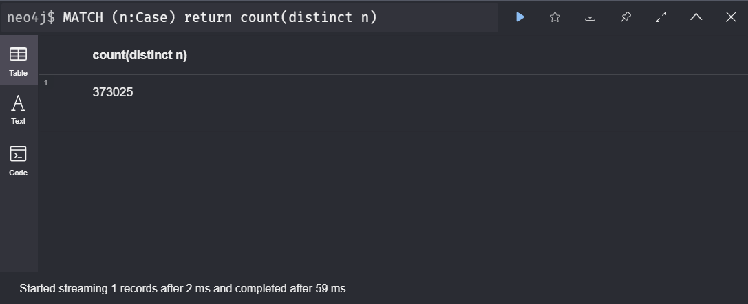
Cypher Query Examples
Distinct Nodes created which are equal to the number of unique records in our dataset.

Slide 16
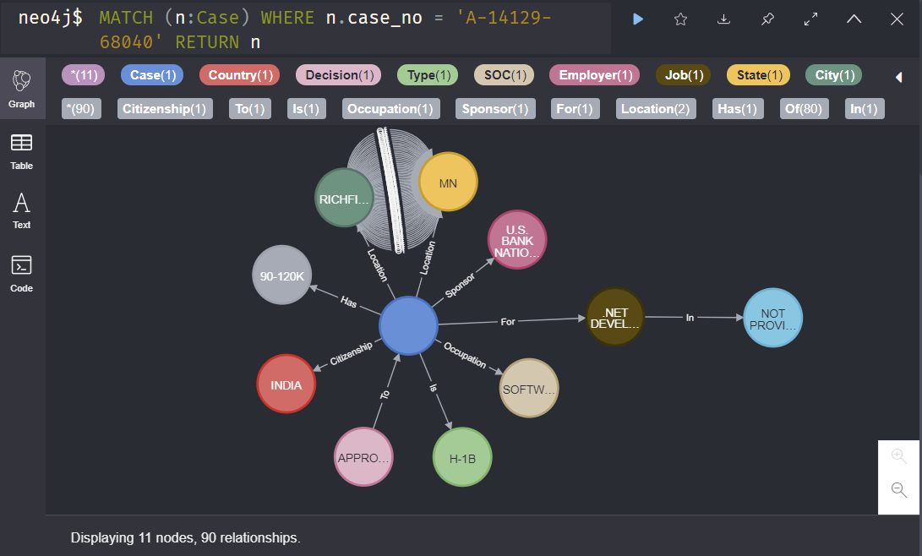
Cypher Query Examples
Example Case Number: A-14129-68040

Slide 17
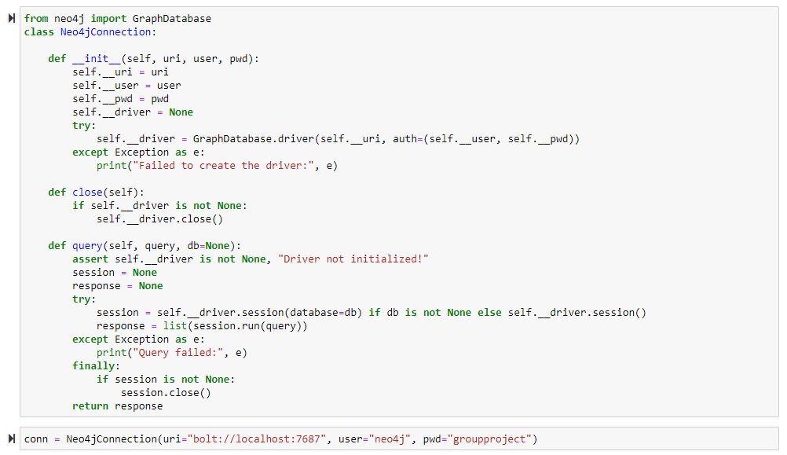
Connecting Neo4j using Python

Slide 18
Target Audience
US Citizenship and Immigration Services
Total number of Approved, Denied, and Withdrawn cases in the US.
They can benefit from cases segregated based on visa admission, countries, different companies of the US located in different states.
Understand the data of visa cases in each frequency.
Corporates of different sectors
Corporates can use this data at the time of visa application filling of their employees
The dashboard will give them an edge for filling visa requests as they can compare their visa request data with another company's data.
Corporates and diversify their employees using the dashboard insights
Immigrants applying for US Visa
Immigrants can look insights according to their class of admission or visa application that they are applying for
Different year insights of approve, deny, or withdraw data will help people to understand their chances of getting their visa application accepted

Slide 19
Benefits of US Visa Application tracker dashboard
Drill down segregation of approved, denied, and withdrawn visa applications using State, City and then company for better insights.
Understanding of which class of admission visa application is approved most and got rejected most
The observation of with kind of companies are majorly getting visa application approved and applied
Country wise Visa application tracker for better understanding of visa application status
It helps to fill the critical gaps among the people who are applying for visa application and their doubts will get cleared
Quick exploration around the dashboard will give idea about feature analysis of visa application
Filter based on country, class of admission and employee job title will help better navigate through the dashboard

Slide 20
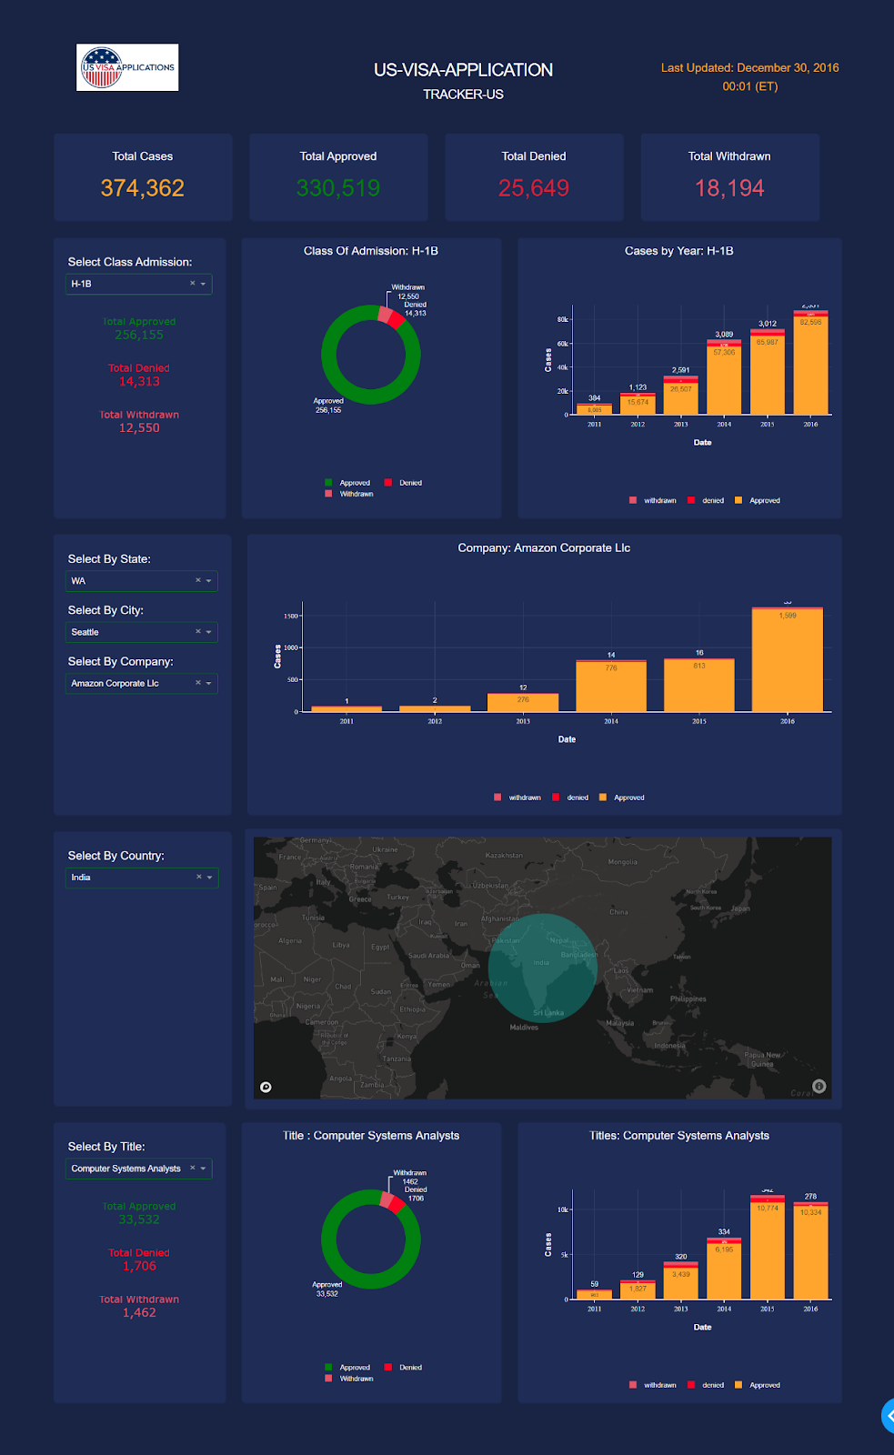
Data Visualization - Dashboard

Slide 21
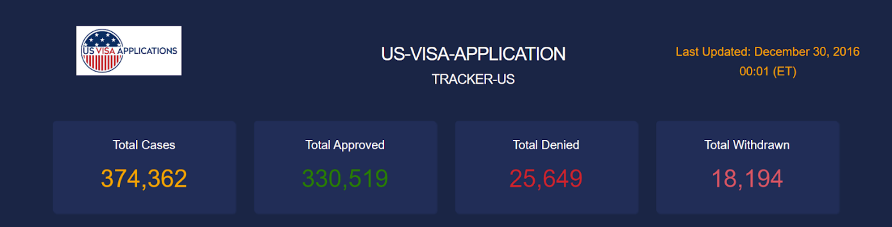
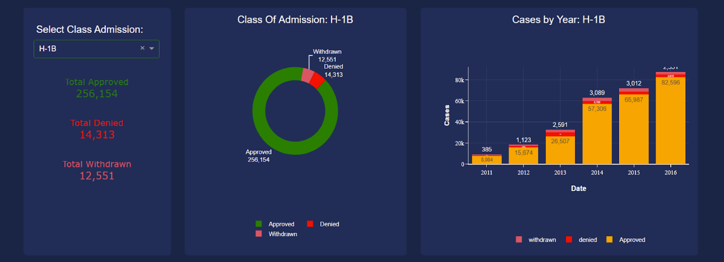
Dashboard Insights
Total Cases of approved, denied and approved also with last date of file to get updated
Most number of applications to get approved based on Class of Admission. We found that H-1B is the top visa application that is applied through the different companies and most approved visas.

Slide 22
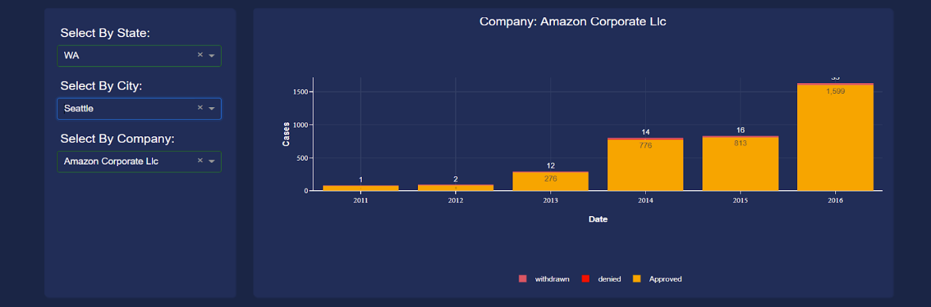
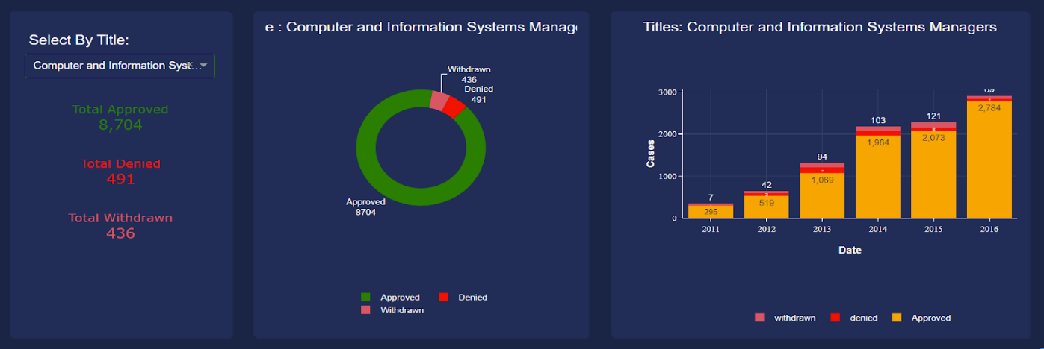
Dashboard Insights
Amazon is amongst top 5 companies that file the highest number of visa applications and gets approved and after drill down through state and city we found that amazon campus at Seattle files the most of amazon visa application and by time it is in increasing fashion
Computer Engineering is the hottest job for which companies are filling visa application and has highest rate of approval

Slide 23
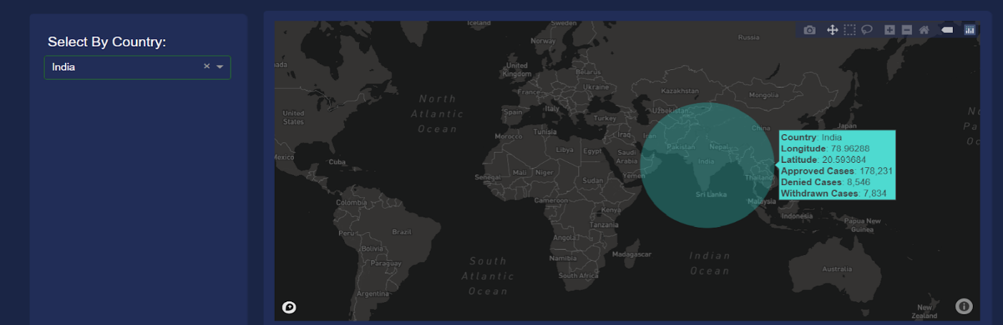
Dashboard Insights
India is the country with the most visa applications filed throughout the world and has the most approved cases. The cases appears when we hover over the country

Slide 24
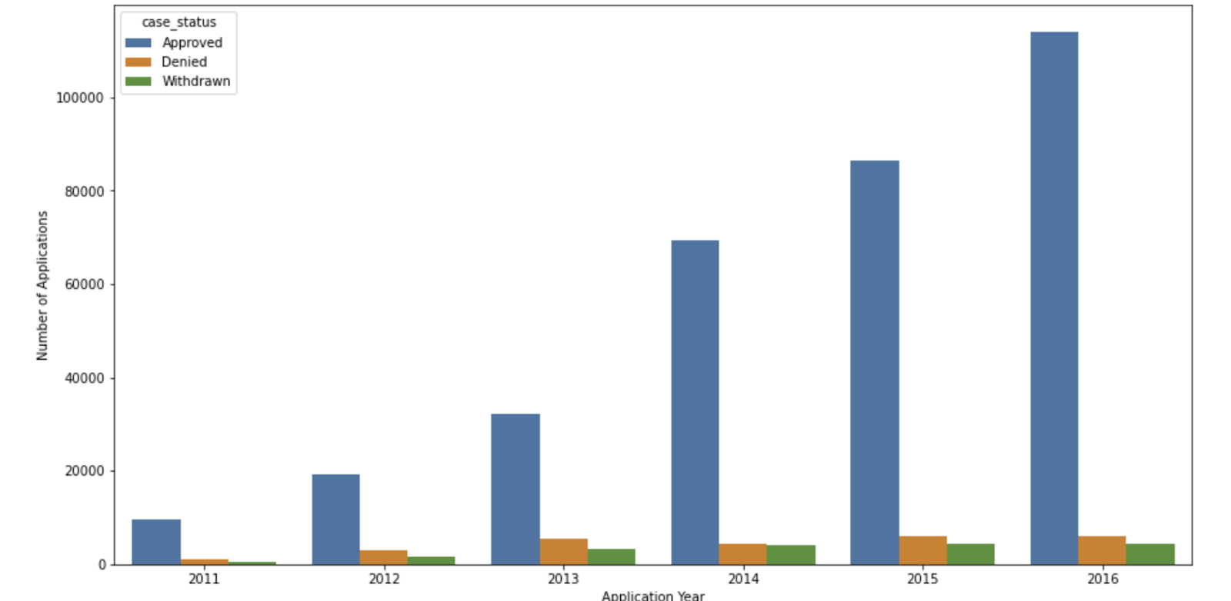
Data Visualization - Matplotlib
Number of applications every year

Slide 25
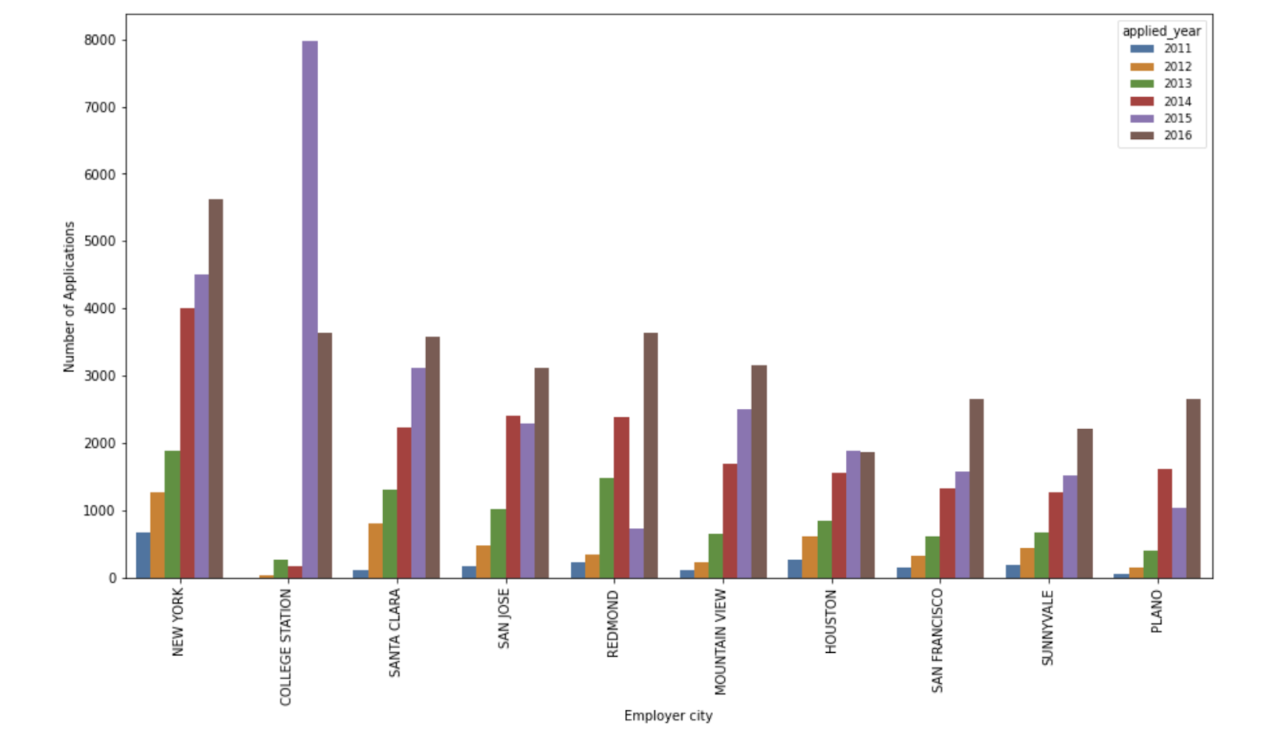
Data Visualization - Matplotlib
City with the greatest number of visa applications

Slide 26
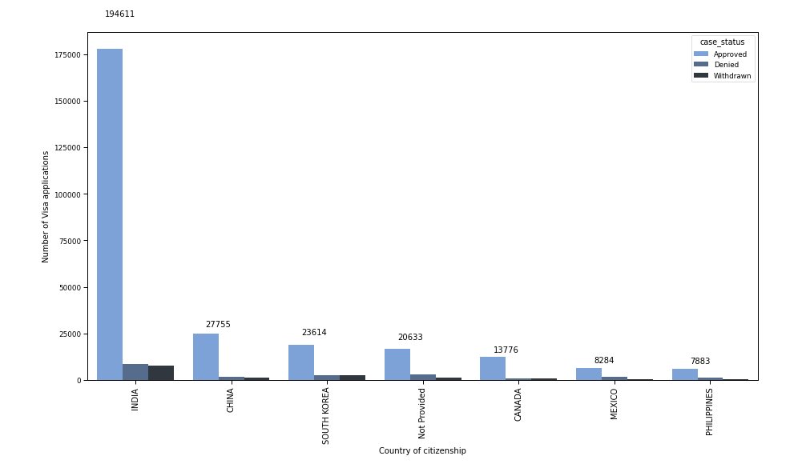
Data Visualization - Matplotlib
Number of applications with respect to the country of citizenship

Slide 27
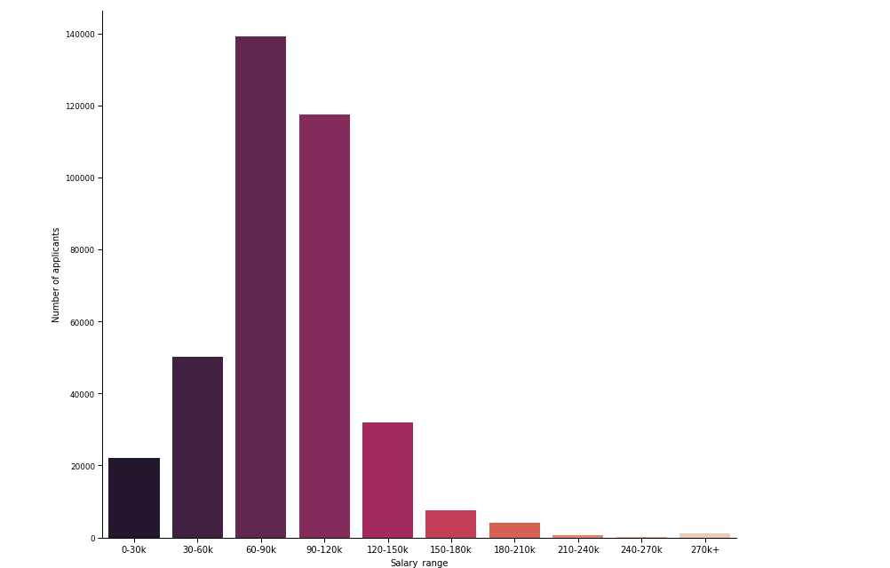
Data Visualization - Matplotlib
Number of applications with respect to the Salary Range, which is the derived column from the pw_amount_9089

Slide 28
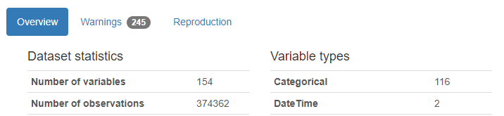
Data Validation
Validating the number of records after every process
Number of records using Pandas Profiling
Number of records after preprocessing using Python libraries
Number of records after processing the data using Alteryx
There is no loss of records after the preprocessing of data

Slide 29
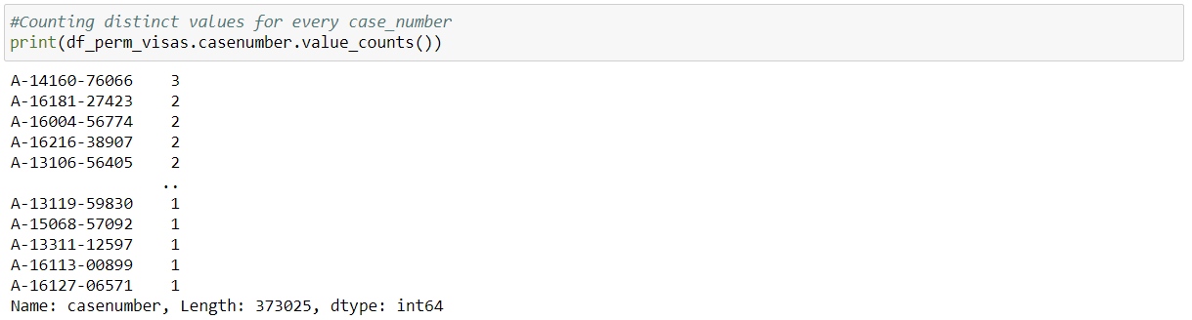
Data Validation
Number of distinct case number in the original dataset – 373025
Number of distinct nodes created for every case

Slide 30
Data Validation
Validating data in the dashboard with respect to the original dataset for User Acceptance Testing
Data in original dataset
Total Cases: 374362
Total Approved Cases: 330519
Total Denied Cases: 25649
Total Withdrawn Cases: 18194
Data shown in the dashboard

Slide 31
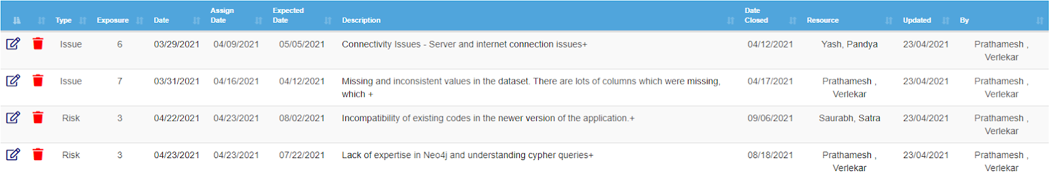
Velero
Risk/Issues:

Slide 32
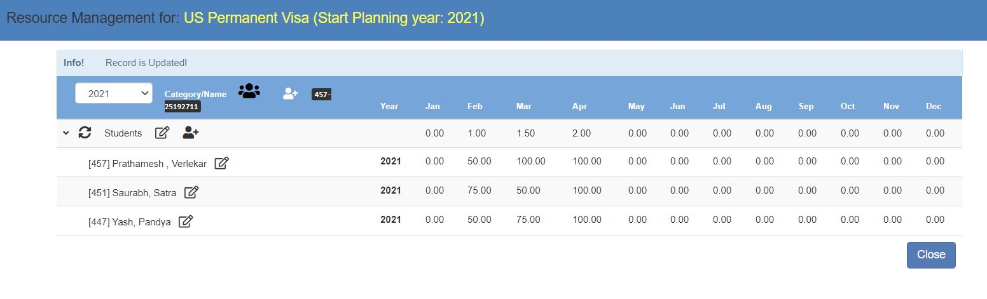
Velero
Resource Management:

Slide 33
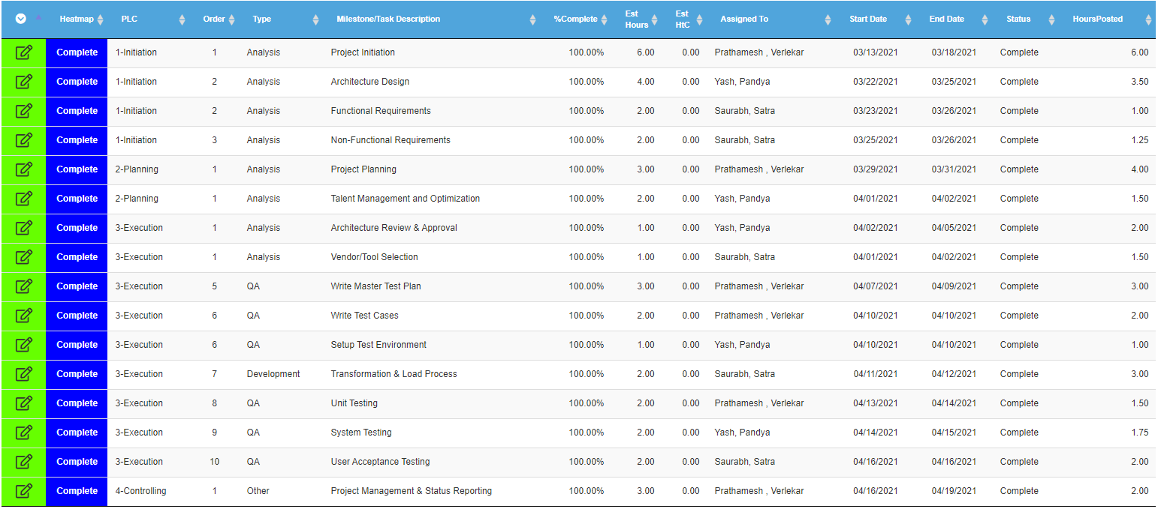
Velero
Project Planning:

Slide 34
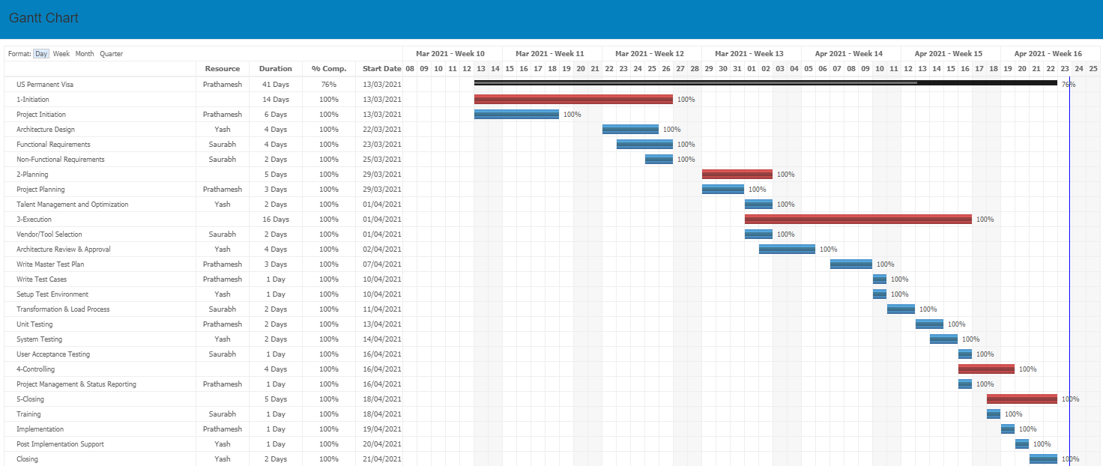
Velero
Gantt Chart:

Slide 35
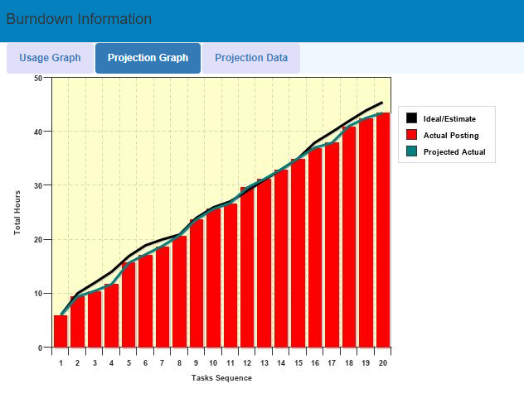
Velero
Burndown Information

Slide 36
Thank you

